Slide 1
Predicting Particle Properties Training a Neural Network to characterise particles in Laser Tweezers
Lachlan Hamilton

Slide 2

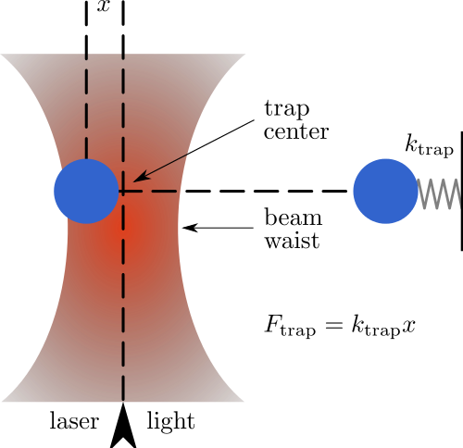
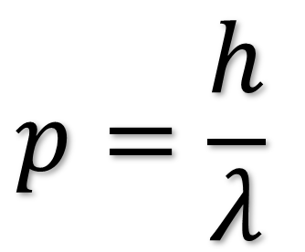
Laser Tweezers
$$p=\frac{h}{λ}$$
Notes:
Images:
https://en.wikipedia.org/wiki/Optical_tweezers

Slide 3
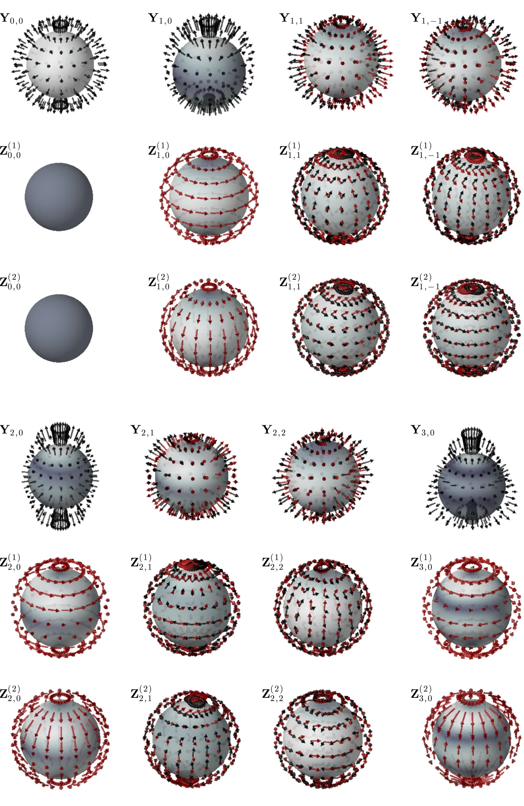
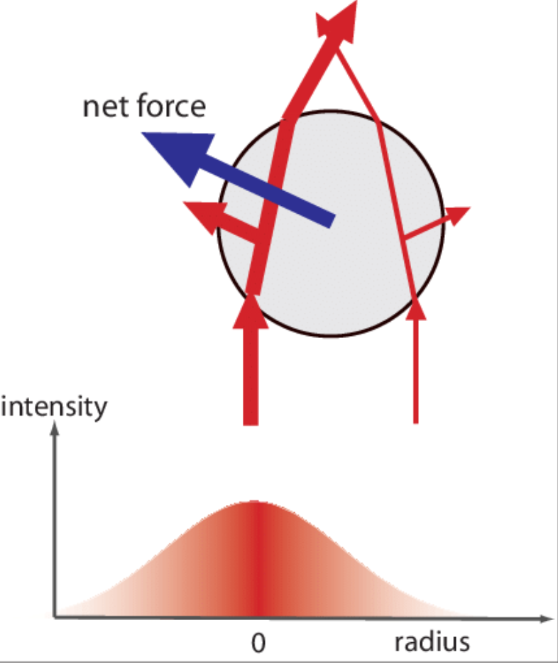
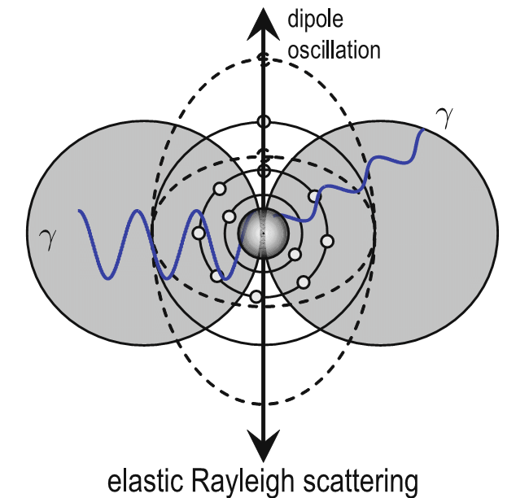
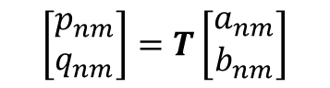
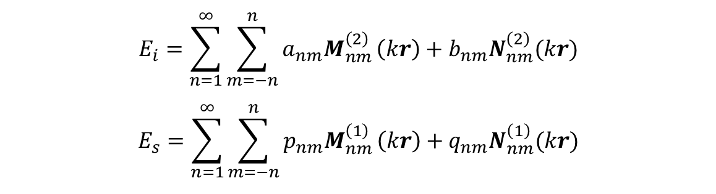
Optical Forces
$$E_{i}=\sum_{n=1}^{∞}{\sum_{m=−n}^{n}{a_{nm}M_{nm}^{\left(2\right)}}\left(kr\right)+b_{nm}N_{nm}^{\left(2\right)}(kr)}$$
$$E_{s}=\sum_{n=1}^{∞}{\sum_{m=−n}^{n}{p_{nm}M_{nm}^{\left(1\right)}}\left(kr\right)+q_{nm}N_{nm}^{\left(1\right)}(kr)}$$
$$\left[\begin{matrix}p_{nm} \\ q_{nm}\end{matrix}\right]=T\left[\begin{matrix}a_{nm} \\ b_{nm}\end{matrix}\right]$$
Notes:
Images:
https://www.researchgate.net/figure/Optical-forces-arising-in-the-ray-optics-regime-A-Momentum-change-of-an-individual_fig16_228334971
http://opticaltweezers.org/chapter-5-electromagnetic-theory/figure-5-5-vector-spherical-harmonics/

Slide 4
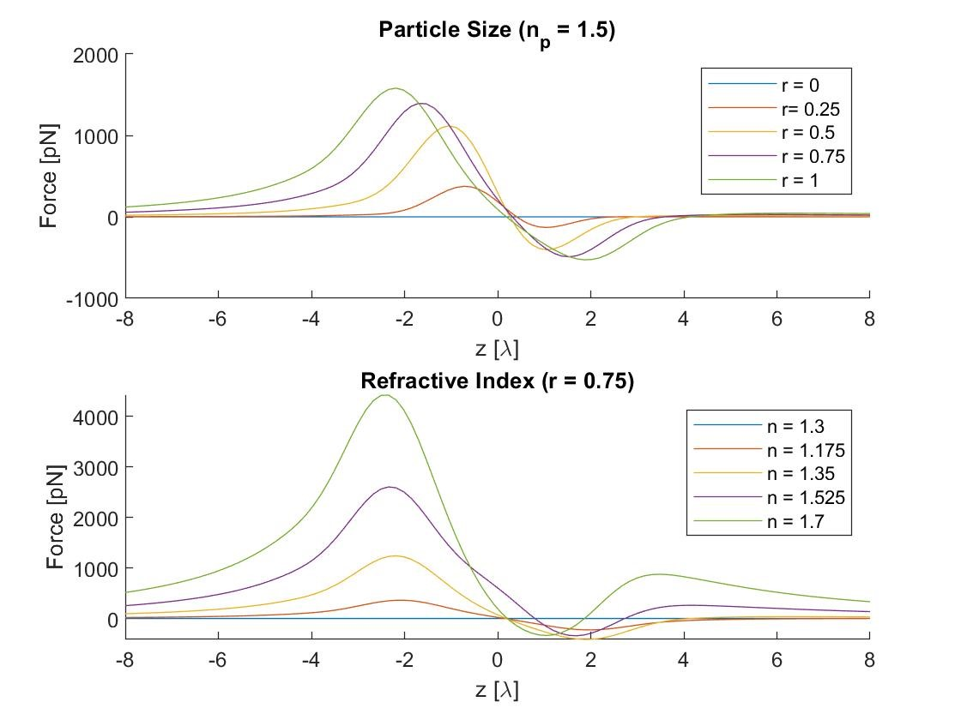
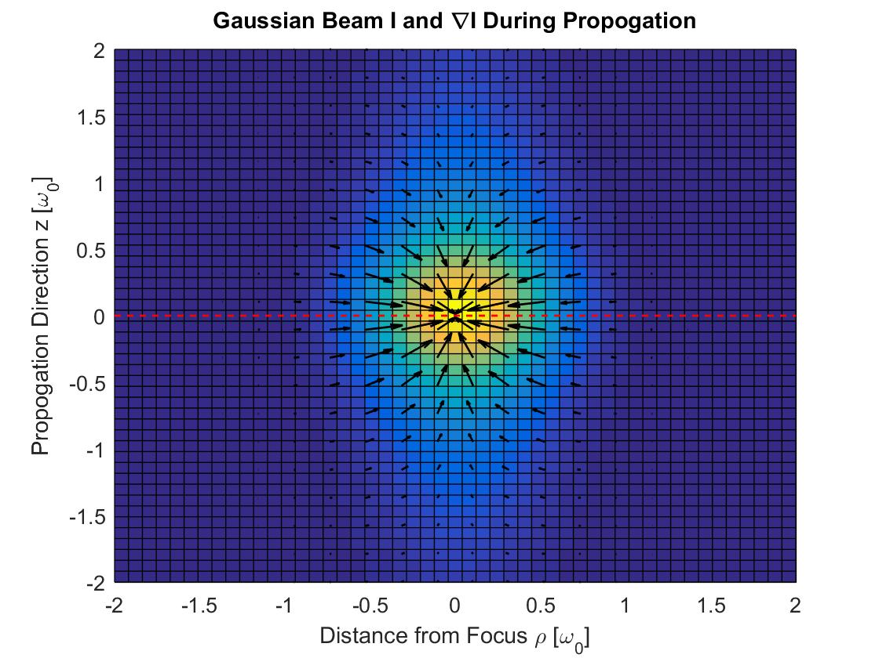
Optical Tweezer Toolbox

Slide 5
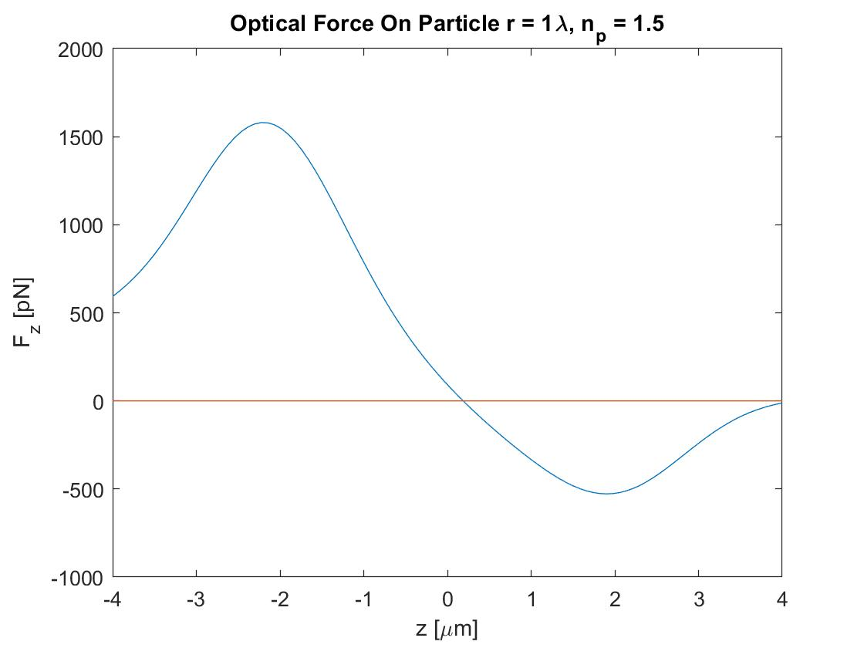
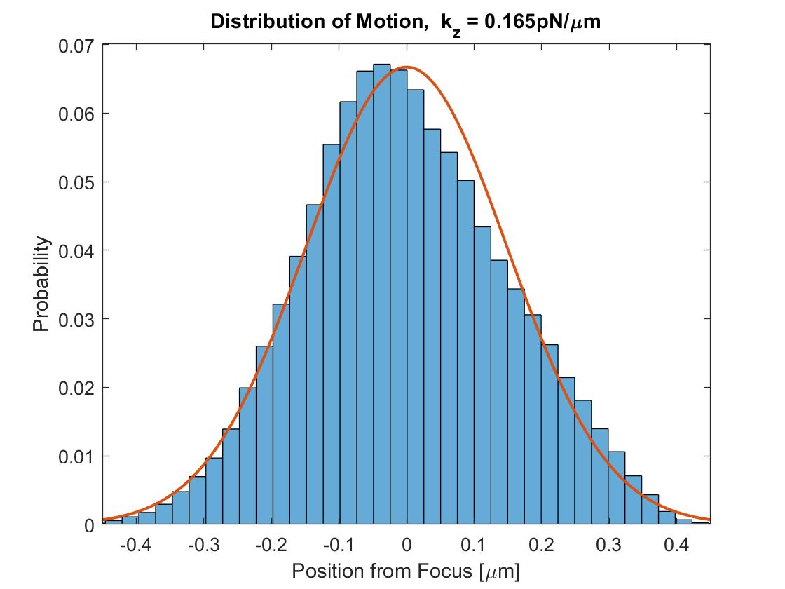
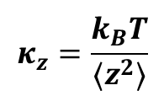
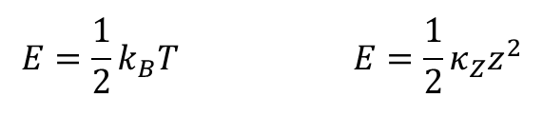

Trap Stiffness
$$F=−κ_{z}z$$
$$E=\frac{1}{2}k_{B}T E=\frac{1}{2}κ_{Z}z^{2}$$
$$κ_{z}=\frac{k_{B}T}{⟨z^{2}⟩}$$

Slide 6
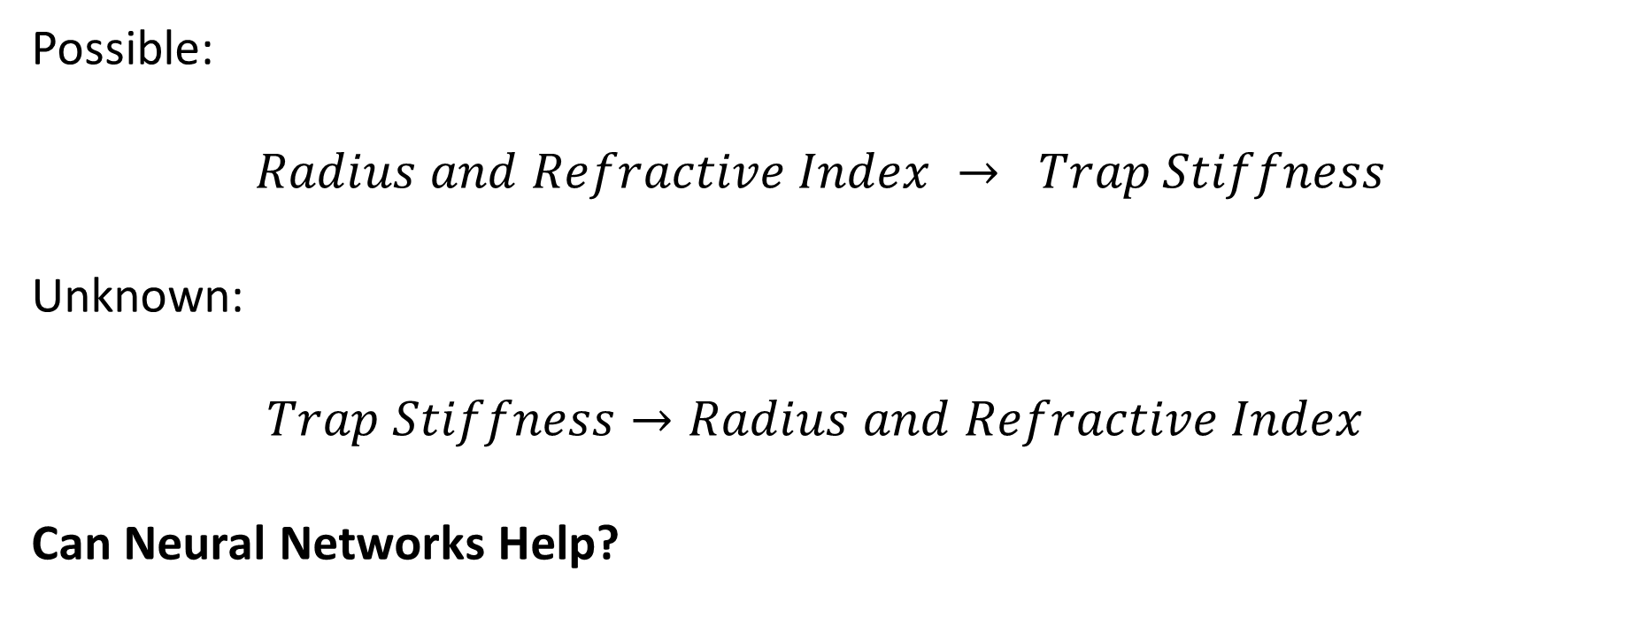
Motivation/Goal
Possible:
$$Radius and Refractive Index → Trap Stiffness$$
Unknown:
$$Trap Stiffness→Radius and Refractive Index$$
Can Neural Networks Help?

Slide 7

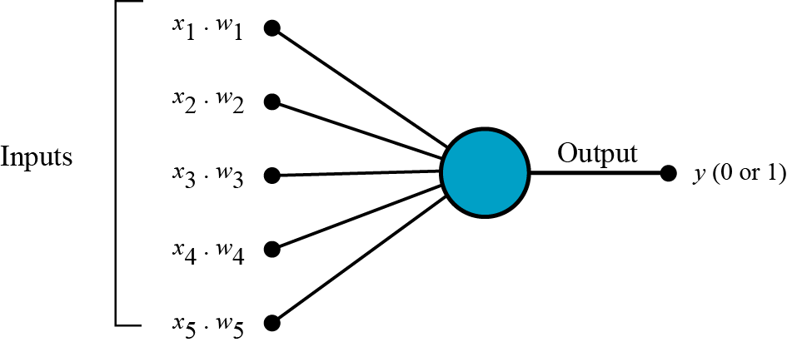
Neural Networks
Notes:
Images:
https://www.researchgate.net/figure/Artificial-neural-network-architecture-ANN-i-h-1-h-2-h-n-o_fig1_321259051
https://towardsdatascience.com/what-the-hell-is-perceptron-626217814f53

Slide 8
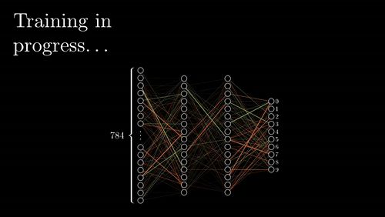
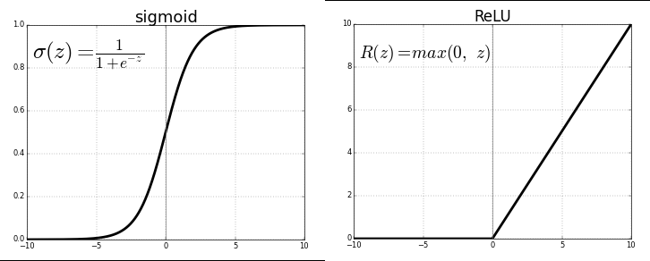
Under the Lid
Activation
Learning
Notes:
Images:
https://towardsdatascience.com/activation-functions-neural-networks-1cbd9f8d91d6
https://gfycat.com/miniaturedependentcob

Slide 9
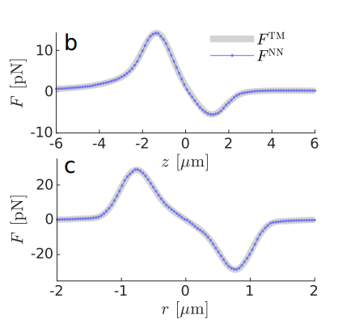
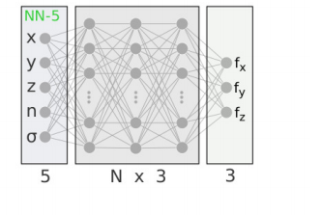

5-DOF Network
$$d\overline{x}=\frac{\overline{F}(\overline{x},n,σ)}{γ}dt+{\overline{ξ}}_{Brownian}(T,γ)$$
Notes:
Images:
“Machine learning enables fast statistically significant simulations of optically trapped microparticles”

Slide 10
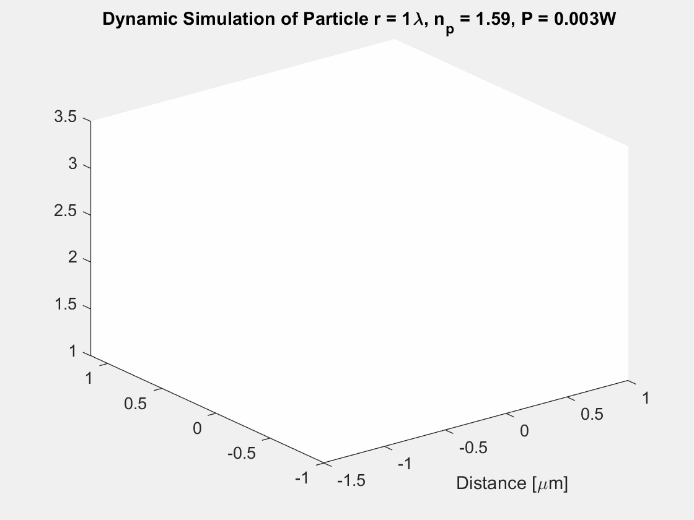
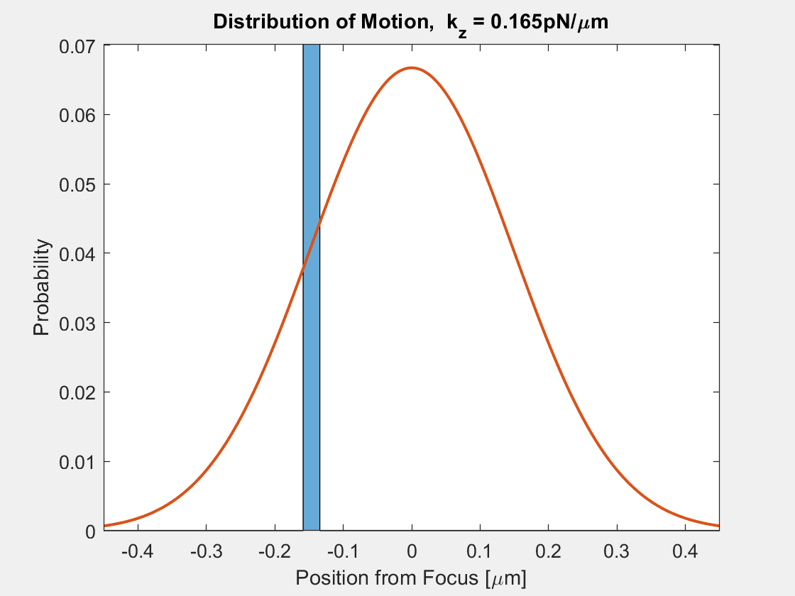
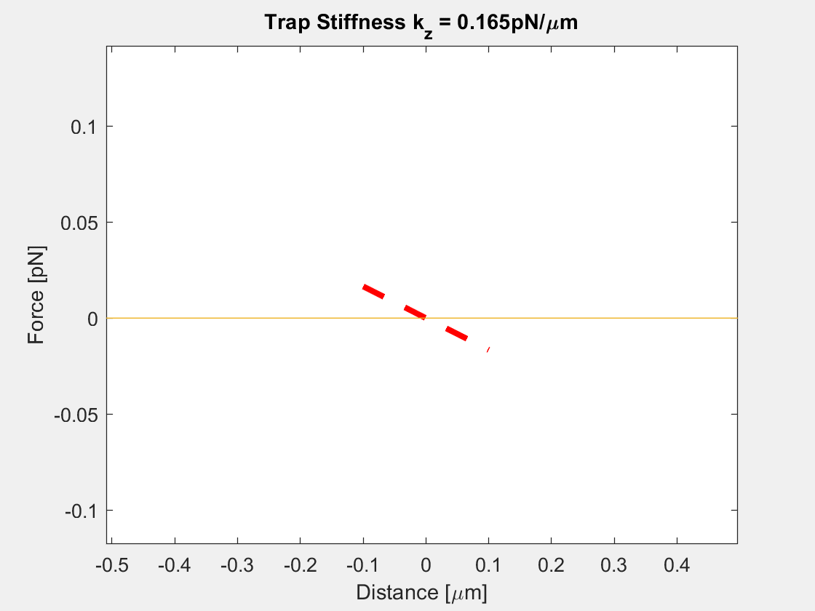
Data Generation

Slide 11
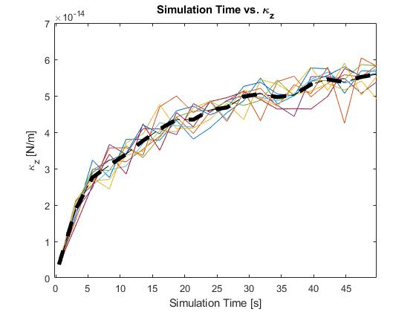
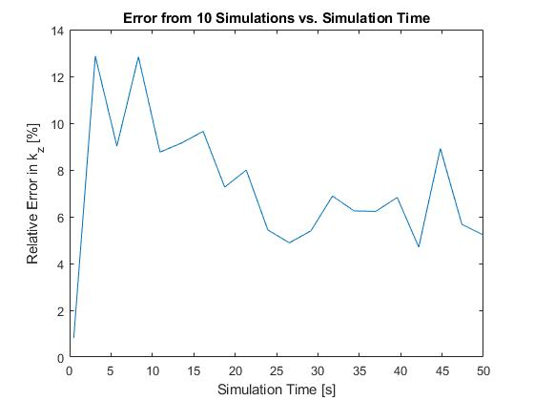
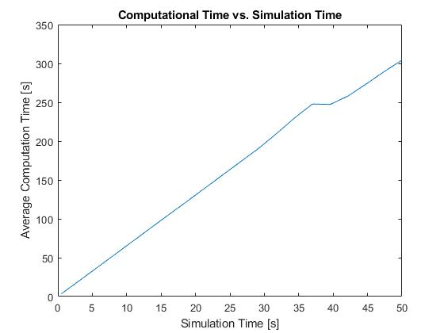
Simulation Parameters

Slide 12
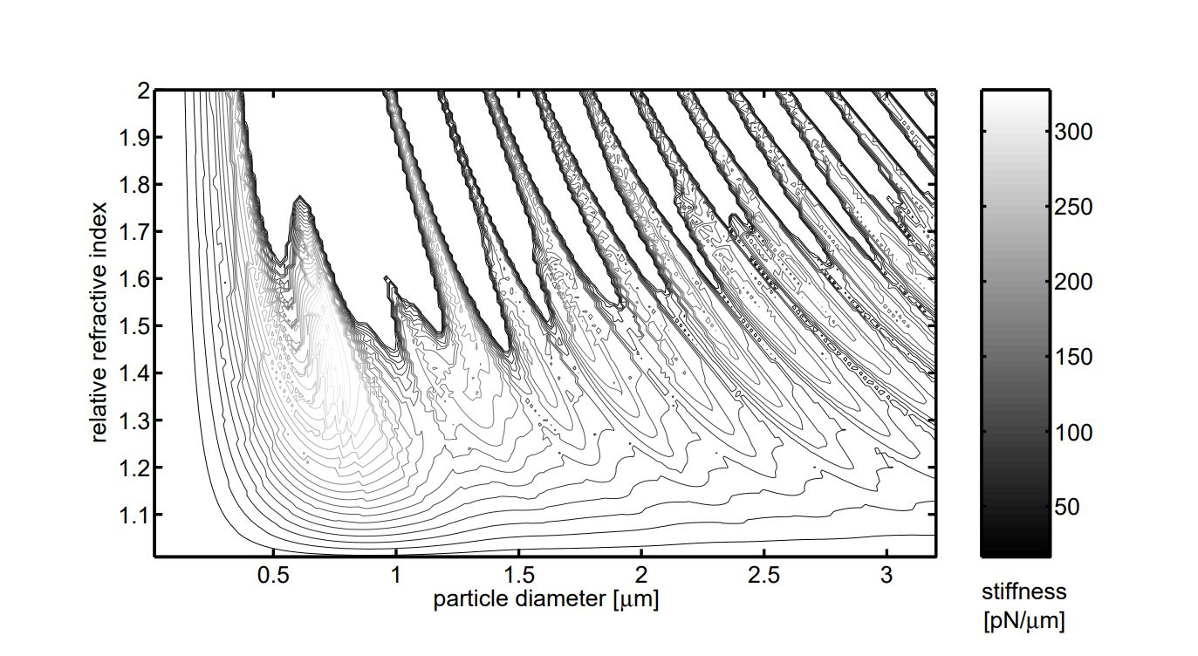
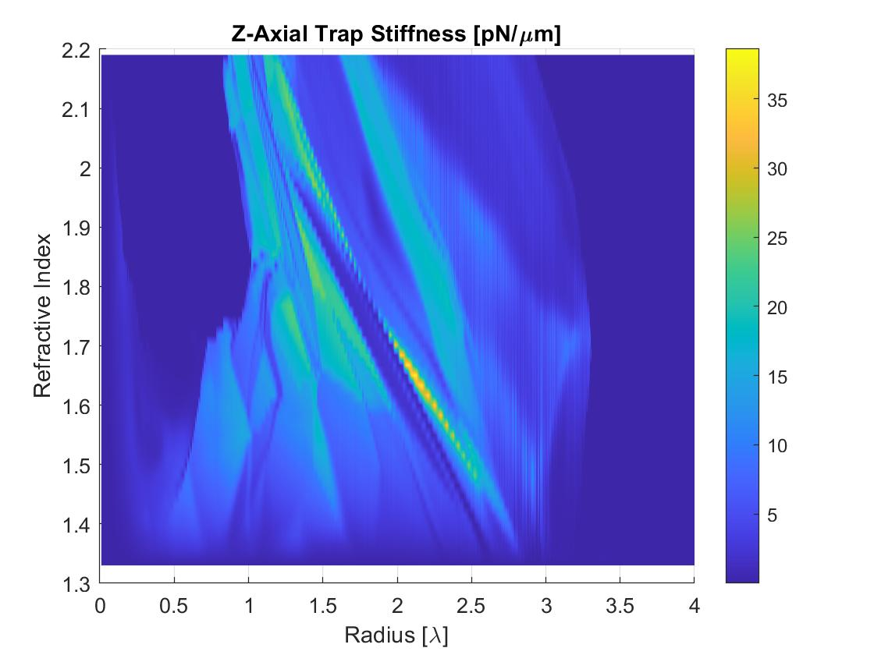
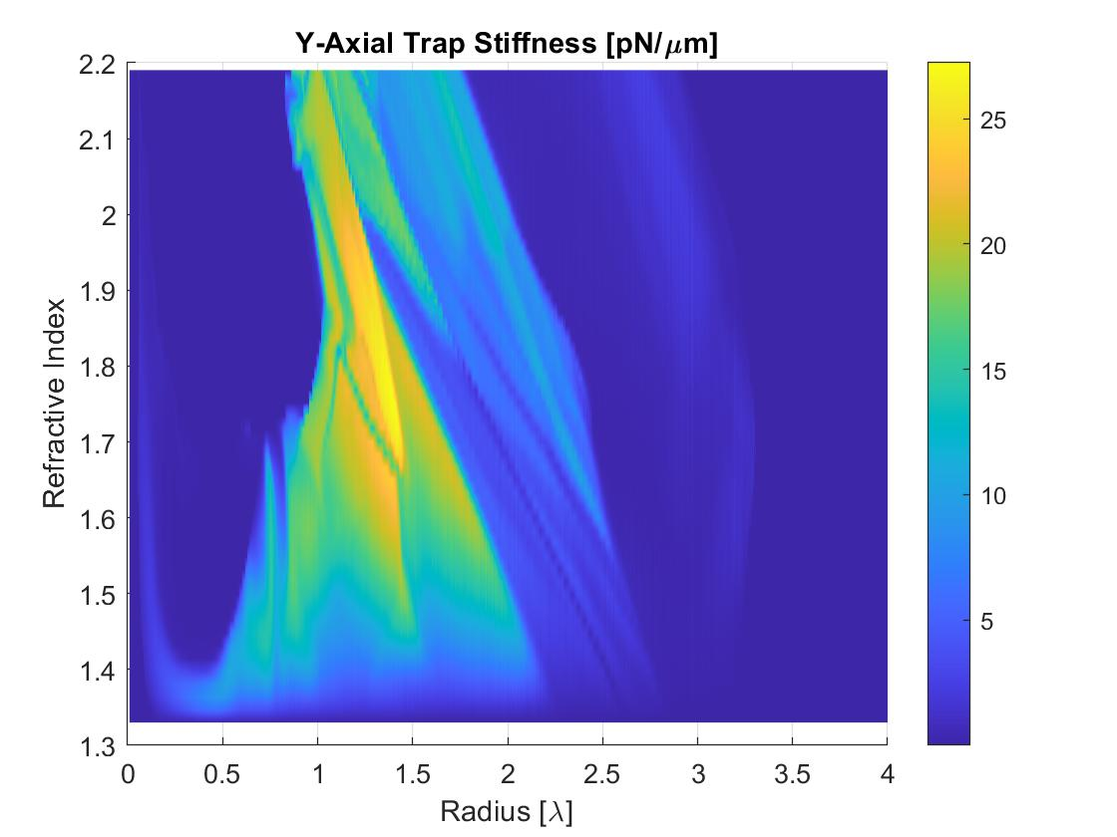
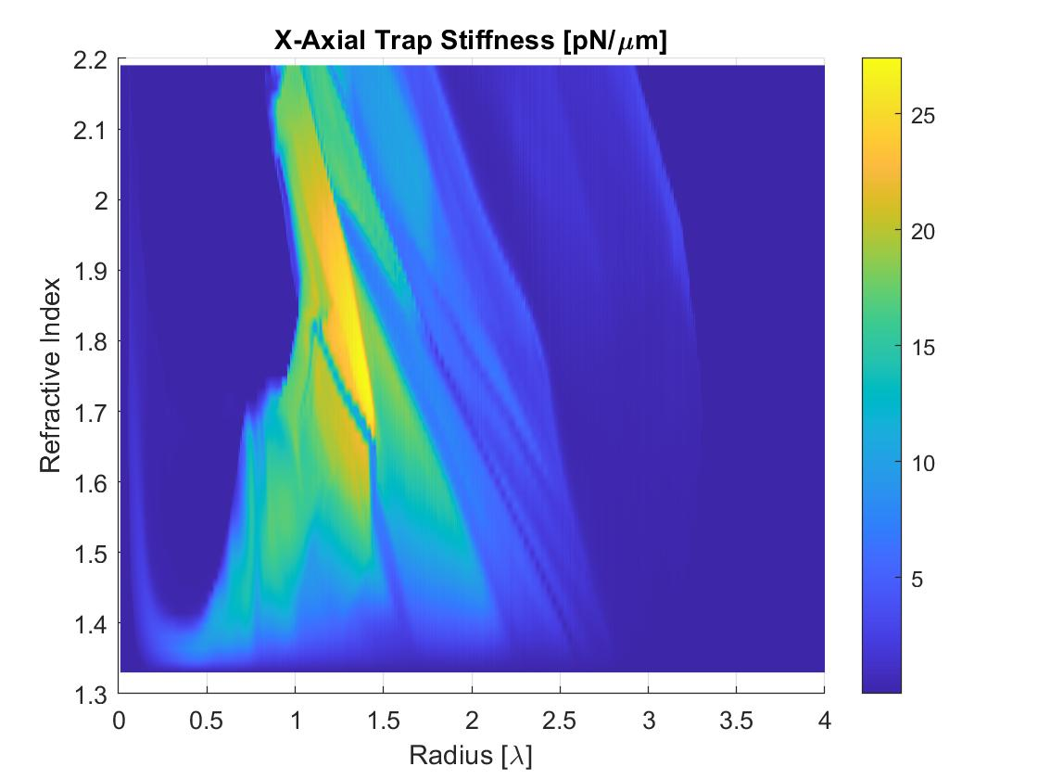
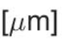
Preliminary Result
Trapping Landscape
Notes:
Images from:
“Calculation of Optical Trapping Landscapes”

Slide 13
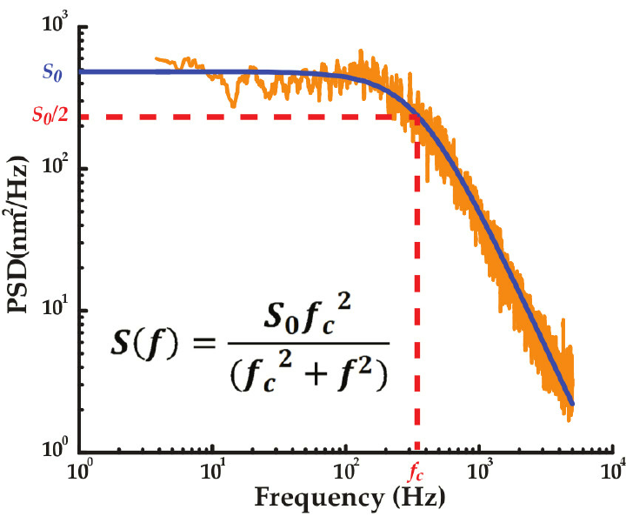
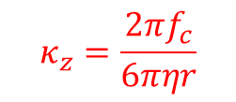
Improving
$$κ_{z}=\frac{2πf_{c}}{6πηr}$$
Notes:
Images:
https://www.researchgate.net/figure/A-power-spectrum-of-the-Brownian-motion-of-a-trapped-bead-The-solid-curve-is-a-fit-to_fig3_265213779

Slide 14

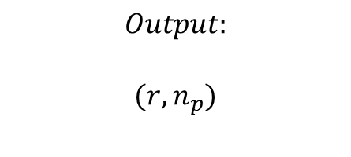
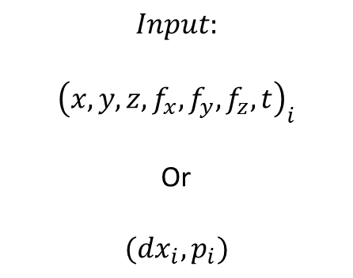
Improving
$$Input:$$
$${\left(x,y,z,f_{x},f_{y},f_{z},t\right)}_{i}$$
Or
$$(dx_{i},p_{i})$$
$$Output:$$
$$(r,n_{p})$$
Notes:
Neural Networks have become so popular in every field. In an age of almost endless data, becoming increasingly useful to ‘leave the lid on’ and get a functional correlation machine.
I worried at first about leaving the ‘real world’ behind and running a simulation from a network to train another network. However, this may well be the way of the future.
Instead of solving for every case every time, teaching a network everything once.
There are some problems we cannot analytically solve, complicated and important relationships can be created through this correlation.
Images:
https://www.researchgate.net/figure/A-power-spectrum-of-the-Brownian-motion-of-a-trapped-bead-The-solid-curve-is-a-fit-to_fig3_265213779

